Slide 1

AUTISM PREDICTION USING ML

Slide 2
Introduction
What is autism?
ASD is a neurodevelopmental disorder that affects the way an individual's brain develops and processes information
People with ASD often struggle with social interactions and communication
Using ML in Predicting ASD
Machine learning models can analyze large datasets of behavioral and clinical information, enabling the early detection of ASD in children
Machine learning algorithms can develop predictive models based on a combination of factors such as genetic markers, brain imaging data, and behavioral assessments
Machine learning can help tailor interventions and therapies for individuals with ASD by analyzing their unique characteristics and response to different treatments.

Slide 3

Autism Prediction using Machine Learning
Understanding Autism:
Autism encompasses various conditions marked by challenges in social interaction, behavior, speech, and nonverbal communication.
Autism Spectrum Disorder (ASD):
ASD, a neurodevelopmental condition, impacts an individual's ability to interact, communicate, and learn.
Project Objective:
This initiative aims to develop a machine learning model and web application for accurately predicting autism traits in individuals of all ages.
Real-World Impact:
Early detection through this tool can lead to timely intervention, providing patients with appropriate support and medication.

Slide 4

Motivation
The motivation behind our work is grounded in the transformative impact it can have on individuals lives through early detection and intervention.
We believe that the integration of machine learning in autism research is not only a technological advancement but a compassionate endeavor with far-reaching implications for the well-being of those affected by ASD.
We seek to inspire further exploration and collaboration in the pursuit of leveraging ML for the benefit of neurodevelopmental health.
Immediate Demand: In today's digital era, there is increase in autism cases which needs to be recognized early.

Slide 5

Problem Statement
To Develop a robust machine learning model to accurately predict the likelihood of autism spectrum disorder (ASD) in individuals based on relevant features.
Challenges:
Limited labeled data: Availability of comprehensive and well-labeled datasets for ASD prediction.
Feature selection: Identifying and incorporating the most relevant features for accurate prediction.
Explainability: Providing interpretability in the model's predictions for better understanding and acceptance.
Outcomes:
A reliable predictive model for early detection of autism.
Insights into key features contributing to ASD prediction.
Contribution to the development of accessible and interpretable tools for autism assessment.

Slide 6

Applications
Early Diagnosis and Intervention
Improved Accuracy
Personalized Treatment Plans
Screening and Assessment Tools
Predictive Analytics
Remote Monitoring
Early Identification of Comorbid Conditions
Research Advancements
Enhanced Parent and Caregiver Support

Slide 7

Common Research Gaps
Limited Diversity in Datasets
Lack of Explainability and Interpretability
Integration of Multimodal Data
Cross-Domain Collaboration
Open-Source Resources
Robustness to Heterogeneity
Ethical Considerations and Privacy

Slide 8
Literature Survey
The literature survey conducted focuses on machine learning models for detecting the early stage of ASD.
Specifically, it discusses the use of feature selection, data pre-processing, and various supervised learning algorithms such as K-Nearest Neighbour (KNN), Naive Bayes (NB), and Logistic Regression (LR).
The survey also highlights the importance of early detection of ASD and the effectiveness of machine learning techniques in achieving this goal.
The proposed PSO-CNN approach has been shown to outperform other methods in terms of accuracy for detecting ASD in toddlers, children, adolescents, and adults .
One of the key challenges in developing machine learning models for ASD detection is the lack of enough ASD datasets and restricted access to them .

Slide 9
Literature Survey – Base Paper
The study explores the use of machine learning algorithms for predicting Autism Spectrum Disorder (ASD) to improve early detection and intervention for individuals with autism.
Various machine learning methods, including Support Vector Machine (SVM), Random Forest (RF), Artificial Neural Network (ANN), Decision Tree (DT), Linear Regression (LR), and Naïve Bayes (NB), among others, are examined in the study.
The research identifies several datasets used for diagnosing ASD, including ABIDE-I, ABIDE-II, UCI Machine Learning Repository, NDAR, Kaggle, Deep, Seed, and figshare data repository.
The advantages and disadvantages of each machine learning algorithm, as well as the applicable tools, applications, and accuracy of each method, are highlighted in the study.
The findings suggest that machine learning algorithms can improve the accuracy of ASD diagnosis and provide early intervention and support for individuals with autism.
The review emphasizes the need for larger and more diverse datasets to enhance the accuracy and robustness of machine learning models for ASD prediction.
The study provides a comprehensive assessment of documents that use machine learning to predict ASD, serving as a valuable resource for researchers and practitioners in the field.

Slide 10
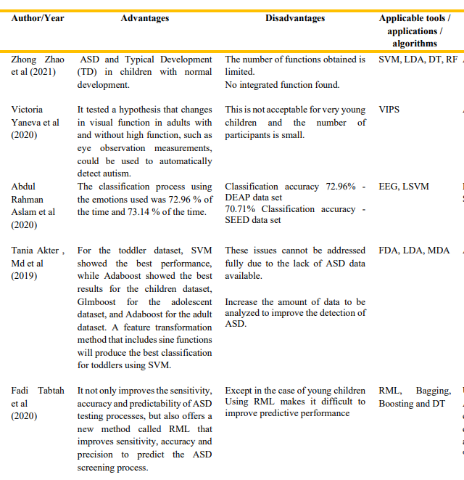
Literature Survey

Slide 11
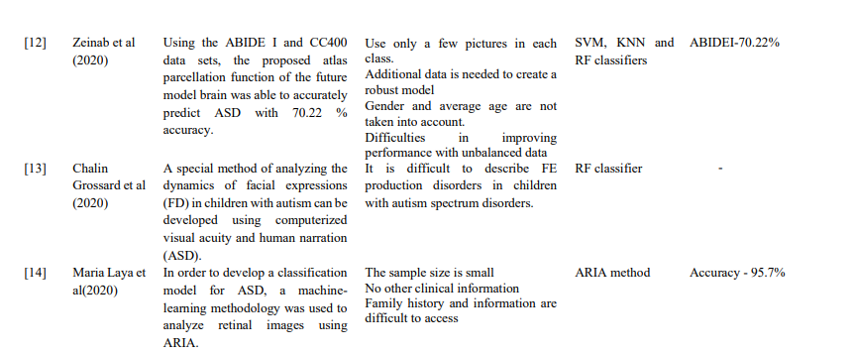

Slide 12
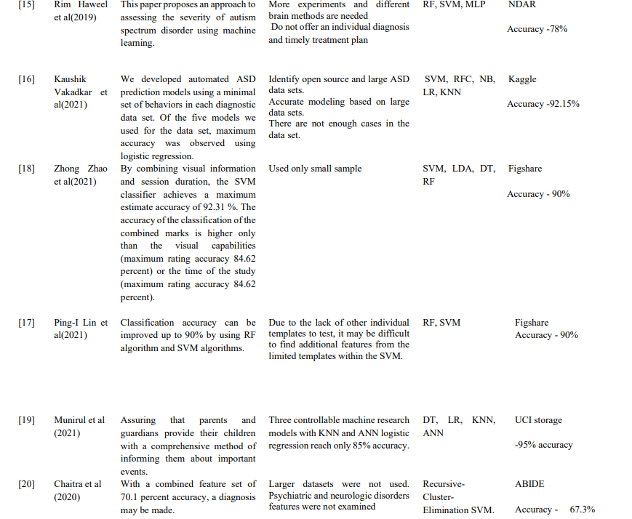

Slide 13
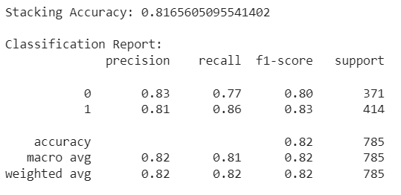
Stacking
Stacking is an Ensemble learning method where multiple base models are trained to make predictions, and then a meta-learner (or blender) is trained to combine the predictions of the base models.
Logistic Regression, XGBoost, and SVM are used as base models to leverage diverse learning approaches.
A Random Forest classifier acts as a meta-learner and is trained on the transposed validation set predictions.
Base models predict on the test set (X_test), and these predictions are transposed for stacking.
The meta-learner predicts the final outcome based on the transposed test set predictions.
Model accuracy and additional metrics, like the classification report, are calculated for evaluation.

Slide 14
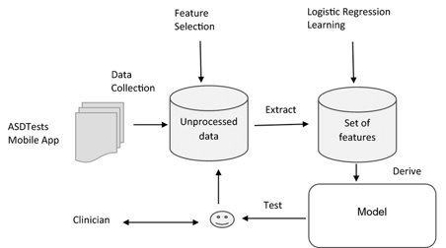
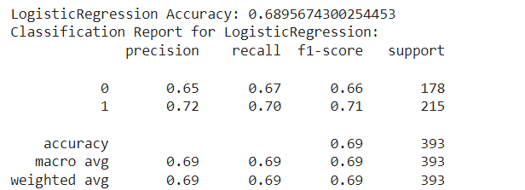
Logistic Regression
Logistic Regression model is instantiated. Logistic Regression is a linear classification algorithm that is commonly used for binary classification tasks.
The Logistic Regression model, is trained on the training data (X and Y). The fit method is used to train each model individually.
Predictions are generated on the test set (X_test) using the predict method.
The code calculates the accuracy and generates a classification report for Logistic Regression model. These metrics provide an evaluation of how well the model performs on the test set.
The confusion matrix is calculated for the Logistic Regression model. The confusion matrix is then visualized using a seaborn heatmap.

Slide 15
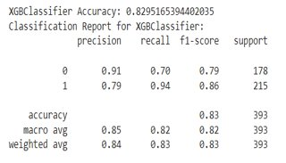
XGBoost
XGBoost classifier (XGBClassifier()) is instantiated. XGBoost is a powerful gradient boosting algorithm that is known for its efficiency and high predictive performance.
The XGBoost classifier, is trained on the training data (X and Y). The fit method is used to train each model individually.
After training the model, predictions are generated on the test set (X_test) using the predict method.
The confusion matrix is calculated for each XGBoost model. The confusion matrix is then visualized using a seaborn heatmap, providing insights into the model's performance in terms of true positives, true negatives, false positives, and false negatives.

Slide 16
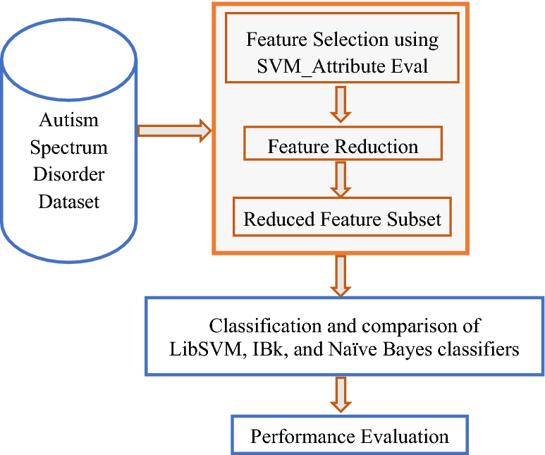
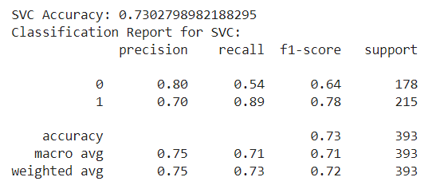
SVM
SVM (Support Vector Machine) with a radial basis function (RBF) kernel is instantiated.
The RBF kernel is a popular choice for SVM and is often used for non-linear classification tasks.
The SVM, is trained on the training data (X and Y). The fit method is used to train the model.
After training model, predictions are generated on the test set (X_test) using the predict method.
The confusion matrix is calculated for each model, including the SVM. The confusion matrix is then visualized using a seaborn heatmap, providing insights into the model's performance in terms of true positives, true negatives, false positives, and false negatives.

Slide 17

Random Forest
Within the loop that iterates, XGBoost is trained individually on the entire training dataset (X and Y)
After training, XGBoost generates predictions on the test set (X_test) as part of the loop.
The accuracy of XGBoost's predictions on the test set is calculated using accuracy_score.
A classification report is generated, providing additional performance metrics.
A confusion matrix is created for XGBoost's predictions on the test set, showing counts of true positives, true negatives, false positives, and false negatives.
The confusion matrix is visualized using a seaborn heatmap, providing a graphical representation of the model's performance in predicting true and false classifications.

Slide 18
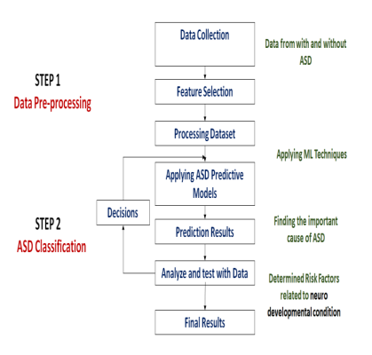
Flow of Work

Slide 19
Developing a Web Application
A mobile application was developed for the use of general mass. By answering a set of closed ended questions, user will get a result of having or not having autism traits.
Using algorithms like XGBoost, Random Forest, and Logistic Regression, a web application is developed to detect the presence of autism spectrum disorder based on a variety of factors using the various parameters that the user entered in the front end.
Streamlit framework was used to create the application.
Data visualization tools are used within the application to provide users with interactive and understandable representations of their results. This could include charts, graphs, and infographics that simplify complex data and offer insights into the user's scores across different parameters.

Slide 20
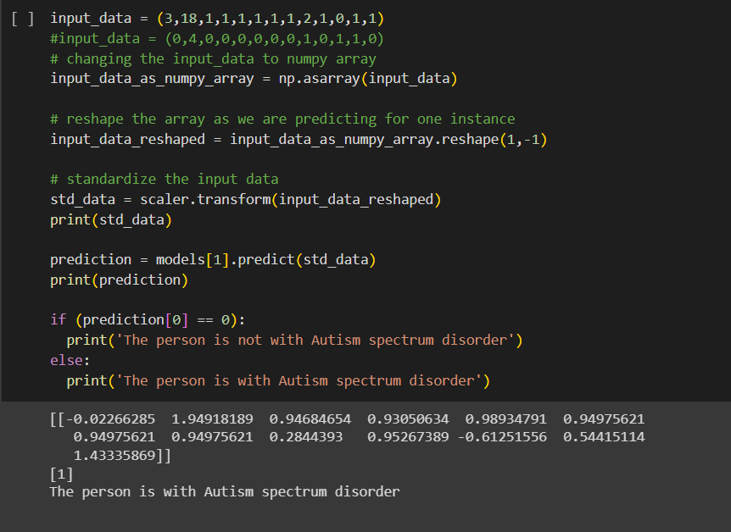
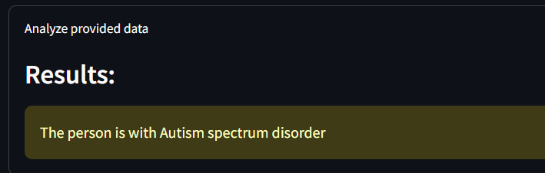
Result
Output from Google Collab:
Output from Streamlit Web Application when giving the same inputs:

Slide 21
Output Evaluation
Input Data:
The input data is represented as a tuple (0, 4, 0, 0, 0, 0, 0, 0, 1, 0, 1, 1, 0). Each value corresponds to a feature.
Data-Splitting and Normalization:
The input data is reshaped using NumPy to be compatible with the model, and then it is standardized using a scaler (assuming scaler is defined elsewhere in your code). Standardization is a common preprocessing step that ensures all features have a mean of 0 and a standard deviation of 1.
Prediction:
The standardized data is then used to make a prediction using a machine learning model (classifier). The prediction is 0.
Output Interpretation:
The output prediction is 0, and based on your conditional statement, it's interpreted as "The person is not with Autism spectrum disorder."
So, according to the model, the input data provided is classified as not indicative of Autism spectrum disorder.

Slide 22
Future Scope
Developing more accurate and efficient machine learning models for ASD detection that can handle large and complex datasets .
Exploring the use of deep learning techniques such as Convolutional Neural Networks (CNNs) for ASD detection .
Collecting more ASD datasets and making them more accessible to researchers to improve the accuracy and generalizability of machine learning models .
Investigating the use of non-invasive techniques such as eye-tracking and electroencephalography (EEG) for ASD detection .
Developing machine learning models that can predict the severity of ASD symptoms and help with personalized treatment planning .
Implemented a app to check if a person has Autism Spectrum Disorder by answering a set of questions.

Slide 23
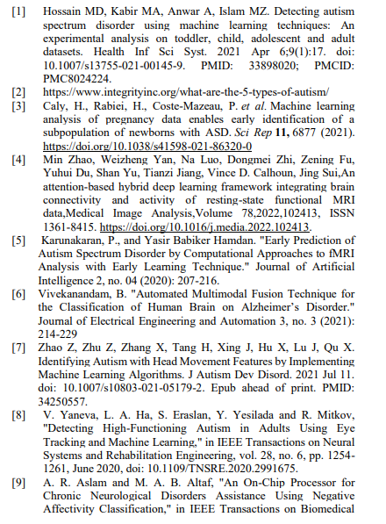

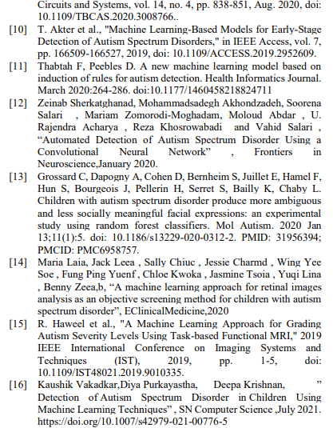
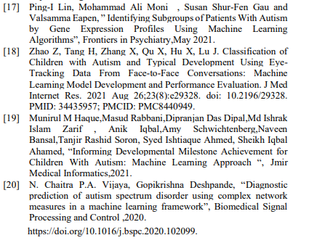
References

